Slide 1
Zonta International and the Istanbul Convention The Council of Europe Convention on Preventing and Combating Violence against Women and Domestic Violence
ZI Council of Europe Committee
Updated December 2016

Slide 2
Notes:
Zonta International‘s vision and mission

Slide 3
What is “The Istanbul Convention”?
The Council of Europe (CoE) Convention on Preventing and Combating Violence against Women and Domestic Violence
The most far reaching international treaty to tackle this serious violation of human rights
Aims at zero tolerance and is a major step forward in making Europe and beyond safer
Notes:
The Istanbul Convention (CETS 210)
The Convention is based on the understanding that violence against women is a gender-based violence that is committed against women solely because they are women and that it comes out of a global culture of discrimination which denies women equal rights with men.

Slide 4
The Core Values of the Convention
The Istanbul Convention
By accepting the Convention
Governments are obliged to change their laws to correspond the obligations of the Convention
For the first time in history
The Convention makes it clear that violence against women can no longer be considered a private matter
To make sure they can rebuild their own lives.
Is based on recognizing violence against women as a human rights violation, based on her gender
To introduce practical measures
To allocate sufficient resources and create a zero tolerance zone for violence
States have an obligation to prevent violence, protect victims and punish the perpetrators.
Preventing and combating such violence is no longer a matter of goodwill but a legally binding obligation.
Requires states to implement gender equality policies and to empower women
Notes:
The convention claims the implementation of measures to fulfill its core issues: protection, prevention and prosecution.

Slide 5
Convention Data: Who has acceded to the Istanbul Convention?
The Istanbul Convention was signed on 11 May 2011 in Turkey by 13 Council of Europe member states and came into force on 1 August 2014.
As of November 2016 it was signed by 20 Council of Europe member states and ratified by 22 member states.
Find out which countries signed/ratified the Istanbul Convention: http://www.conventions.coe.int/Treaty/Commun/ChercheSig.asp?NT=210&CM=&DF=&CL=ENG
Notes:
”The Council of Europe (CoE) Convention on Preventing and Combating Violence against Women and Domestic Violence”
was signed on 11 May 2011 in Turkey- therefore named “Istanbul Convention.“ As of today 20 member states have signed the convention but not yet ratified. 22 member states have ratified the convention.

Slide 6
Can non-European Countries join?
Yes!
The Convention is open to accession by any country in the world
Provided that the country has been formally invited to accede by the Committee of Ministers of the Council of Europe
The procedure for accession
Prior to acceding, the state has to take the necessary measures to ensure that its domestic law allows the Convention to be implemented.
The Committee of Ministers will ask for contributions to finance the follow-up mechanism.
It is customary for the non-member state to request accession in a letter addressed to the Secretary General of the CoE.
Notes:
Non-European countries can join, provided they are being invited and have proven to have taken the necessary measures to allow the domestic law to implement the requirements of the convention.

Slide 7
What does the Convention require the states to do?
Provide safety and support for victims to rebuild their lives:
Free national telephone helpline
Shelters in sufficient numbers
Protect victims at risk by introducing:
Restraining and protection orders
Invest in preventative measures to:
Tackle the root problem of violence against women – inequality and discrimination
Medical, psychological and legal counselling
Help with housing and financial issues
Support in finding employment
Risk assessment and risk management
Arrange campaigns and educational programs to change attitudes, gender roles and stereotypes. Partner with the media and the private sector
Empower women
Involve men and boys
Support NGOs and their work at the service of victims of violence
Emergency barring orders

Slide 8
Statistics on violence against women
Worldwide, intimate partner violence is the most common type of violence against women, affecting 30 percent of women
Approximately 100 to 140 million girls and women in the world have experienced female genital mutilation
Across member states of the CoE, 20-25 percent of all women have experienced physical violence at least once during their adult lives and more than 10 percent have suffered sexual violence involving the use of force
12-15 percent of European women over 16 suffer domestic abuse in a relationship
Between 40 – 50 percent of women in EU countries experience unwanted sexual advancements, physical contact or other forms of sexual harassment in their workplace
Notes:
Statistics show that violence against women has pandemic dimensions, in Europe and around the world. This also means huge economic consequences.

Slide 9
Why is the Istanbul Convention important to Zonta?
Zonta International strives to promote and protect the human rights of all women/girls and to reduce violence against women.
Whether in Europe or anywhere else in the world, Zontians can use the Istanbul Convention as a tool for advocacy!
The Istanbul Convention will give more strength to the ‘Zonta says NO!’ campaign!
Notes:
For Zonta the Istanbul Convention is a practical tool to advocate for gender equality and women‘s rights and to take advocacy into action, also as heart of the Zonta Says NO-Campaign.

Slide 10
Synergy
The Convention covers all women and girls, from any background, regardless of their age, race, religion, social origin, migrant status or sexual orientation.
The Convention recognises that there are groups of women and girls that are often at greater risk of experiencing violence, and states need to ensure that their specific needs are taken into account.
Advocacy is one important part of Zonta’s mission to fight for gender equality and women’s rights.
“We need to work to attack the root causes – attitudes, changes in the law and more – to bring about substantial change”.
Sonja Hönig Schough, President
Zonta International
Zonta International Foundation
Notes:
The Istanbul Convention is a practical advocacy tool to raise awareness of the different violations to women and girls and their root causes.

Slide 11
Zonta International can play an active role
First in the process to push their respective states to access the Convention and ratify it.
Later on in the monitoring of the implementation of the Convention.
The group of experts in charge of the monitoring process (GREVIO) may receive info from NGOs (as a complement to the info provided by state/government itself).
ZI can contribute with its power, knowledge and persuasion to see that states/governments become parties to this important Convention
SAFE FROM FEAR
SAFE FROM VIOLENCE
STAND UP AND SPEAK OUT!
Notes:
Zonta can contribute with its power, knowledge and persuasion by raising awareness in all 62 Zonta countries around the world to this first legally binding instrument/treaty to fight VAW and domestic violence. Zontians can follow the monitoring reports of their government and of the Grevio Group in their countries to see if their government meets the requirements of the Istanbul Convention.

Slide 12
What do you need to do?
In your country
Is your country a Member State of the CoE?
If yes, when did it sign the Istanbul Convention? Has it ratified yet?
Within Zonta
Raise awareness among Zonta clubs and convince them about the importance of supporting the Istanbul Convention.
Decide what type of advocacy project you could set up. A conference? A round table?
Write a letter to ask for a meeting with parliamentarians in your country.
Send an article to important newspapers
Talk with like-minded organizations and decide on a joint action
Find out about the situation in your own country
If no, get informed about the laws against violence and find out what type of action you could set up
Read more info in the “Istanbul Convention” text document published on the ZI website
Notes:
Get informed on the situation in your own country, then decide what advocacy-topic your club wants to become active on.

Slide 13
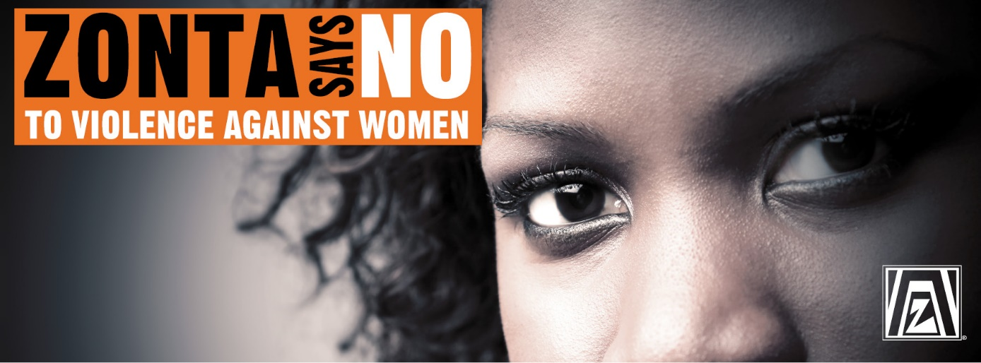
The Istanbul Convention - an essential tool for the Zonta Says NO to Violence Against women campaign and for Zonta advocacy

Slide 14
Zonta International supports the ratification of the Istanbul Convention! www.coe.int/conventionviolence
Equality between women and men can only be achieved if women do not experience gender-based violence and can live to their full potential.

Slide 15
Further information or questions
Anita Schnetzer-Spranger, Chairman, D 28
Zonta Club of Mainz, Germany
schnetzer-spranger@gmx.de
Irma Ertman, Vice-Chairman, D 20
Zonta Club of Helsinki II, Finland
ertman.irma@gmail.com
Frieda Demey, Member, D 27
Zonta Club of Brussel Zavel, Belgium
frie.demey@skynet.be
Anne Kraus, Member, D 27
Zonta Club of Luxembourg- Multiculturel, Luxembourg
krausanne@hotmail.com
Karin Nordmeyer, D 30, Legal Advisor
Zonta Club of Freiburg-Schauinsland, Germany
knordmeyer@gmx.de

